Slide 1

Dr. AI: Your intelligent symptom and remedy guide
Sujatha Alagarsamy
Andy Metz
Younes Smyej
Anitha Pandian
Briana Liu

Slide 2

Dr. AI Overview
Dr. AI is a webpage designed to assist users in finding medication information for over-the-counter prescriptions and discontinued drugs.
The webpage will consist of three tabs: Over the counter, Prescription, and Discontinued. Users can navigate between these tabs to find information related to the medication and gather more details on the usage and purpose of the medication.

Slide 3
Problem statement
Many individuals face challenges when trying to find accurate information about medication for their health concerns.
Reliable and trustworthy sources of information can be difficult to navigate, leading to confusion and potentially incorrect self-diagnosis
Common search engines often provide overwhelming and inconsistent results, making it challenging to find reliable and up-to-date information
The need for a user-friendly and reliable solution that empowers individuals to access accurate and up-to-date information about medication is evident.

Slide 4

solution
Content:
Dr. AI offers a comprehensive solution to the challenges faced by individuals when seeking accurate information about medication.
Dr. AI provides a user-friendly webpage with three tabs: Over the counter, Prescription, and Discontinued to offer a seamless experience for users.

Slide 5

Integration with the FDA Drugs API:
The FDA Drugs API serves as a reliable and up-to-date source of information on drugs, their indications, side effects, and recommended usage.
By integrating with the FDA Drugs API, Dr. AI ensures that users receive accurate and trustworthy information about remedies and medications.

Slide 6

Data Sources
To build the Dr. AI webpage, we used the following data source:
FDA Drugs API: We will utilize the FDA Drugs API to access information about various drugs, including their indications, side effects, and recommended usage. This data will help us provide accurate and up-to-date information on remedies for specific medical conditions.

Slide 7
Technologies used
Flask API
MongoDB
Vue/Node for Javascript
BootstrapVue for CSS
HTML

Slide 8

Medication tab
When the user selects the medication type, a list of medications under the medication category is displayed along with the bar and pie chart visualizations.

Slide 9
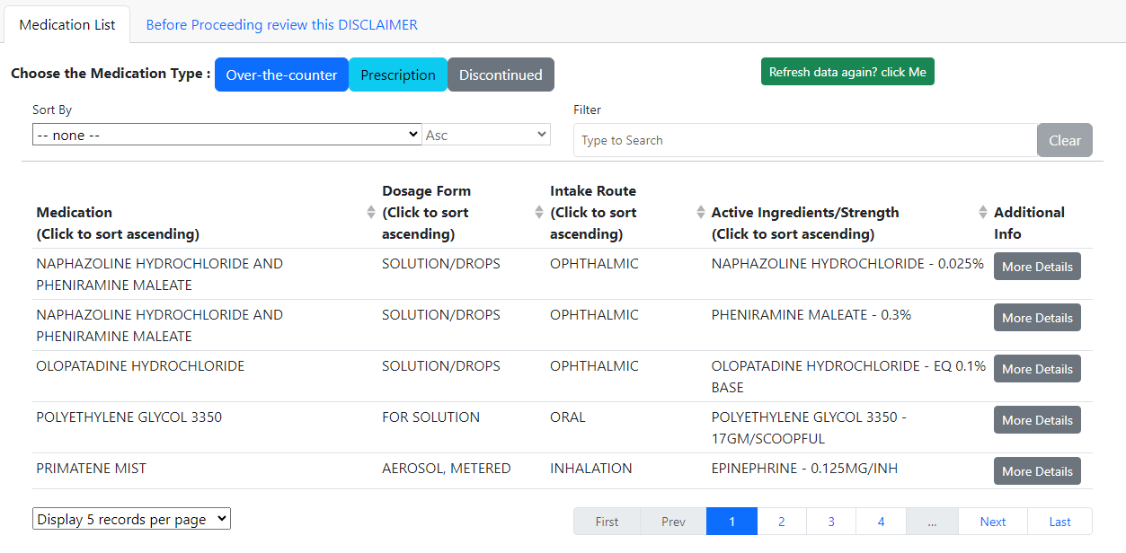

MEDICATION TAB - OVERVIEW

Slide 10
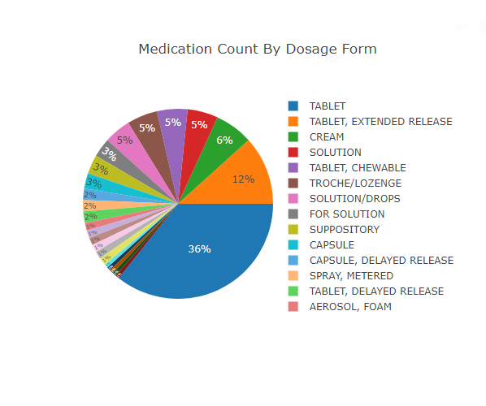
BAR CHART - Visualization

Slide 11

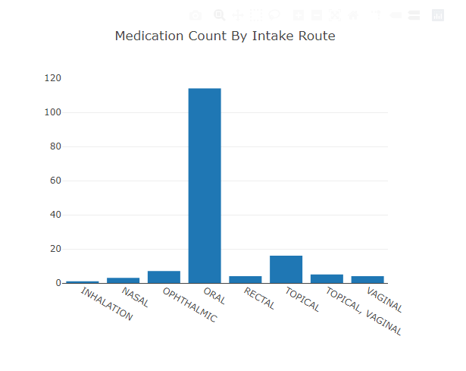
MEDICATION – COUNT BY INTAKE
Add examples from webpage

Slide 12
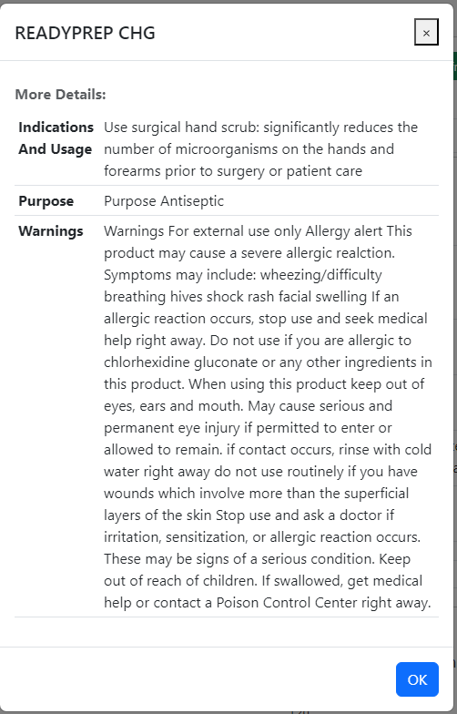

USAGE DIRECTIONS

Slide 13

Flask api calls
API Calls:
'/refresh_data’
'/getMedicationByType/<medication_type>’
'/getCountByCategory/<medication_type>/<category_type>’
'/getMoreDetailsFromFDA/<brand_name>'

Slide 14
Front-end/html/css
Add points

Slide 15
limitations
We limited the API call to 300 records
Medical disclaimer – on the webpage
This cannot be executed as a web application, only as a local host page.

Slide 16

Demo of Dr. AI

